Slide 1
Using Historical Data to Model HIV Prevalence
How Many People are Still in State?

Slide 2
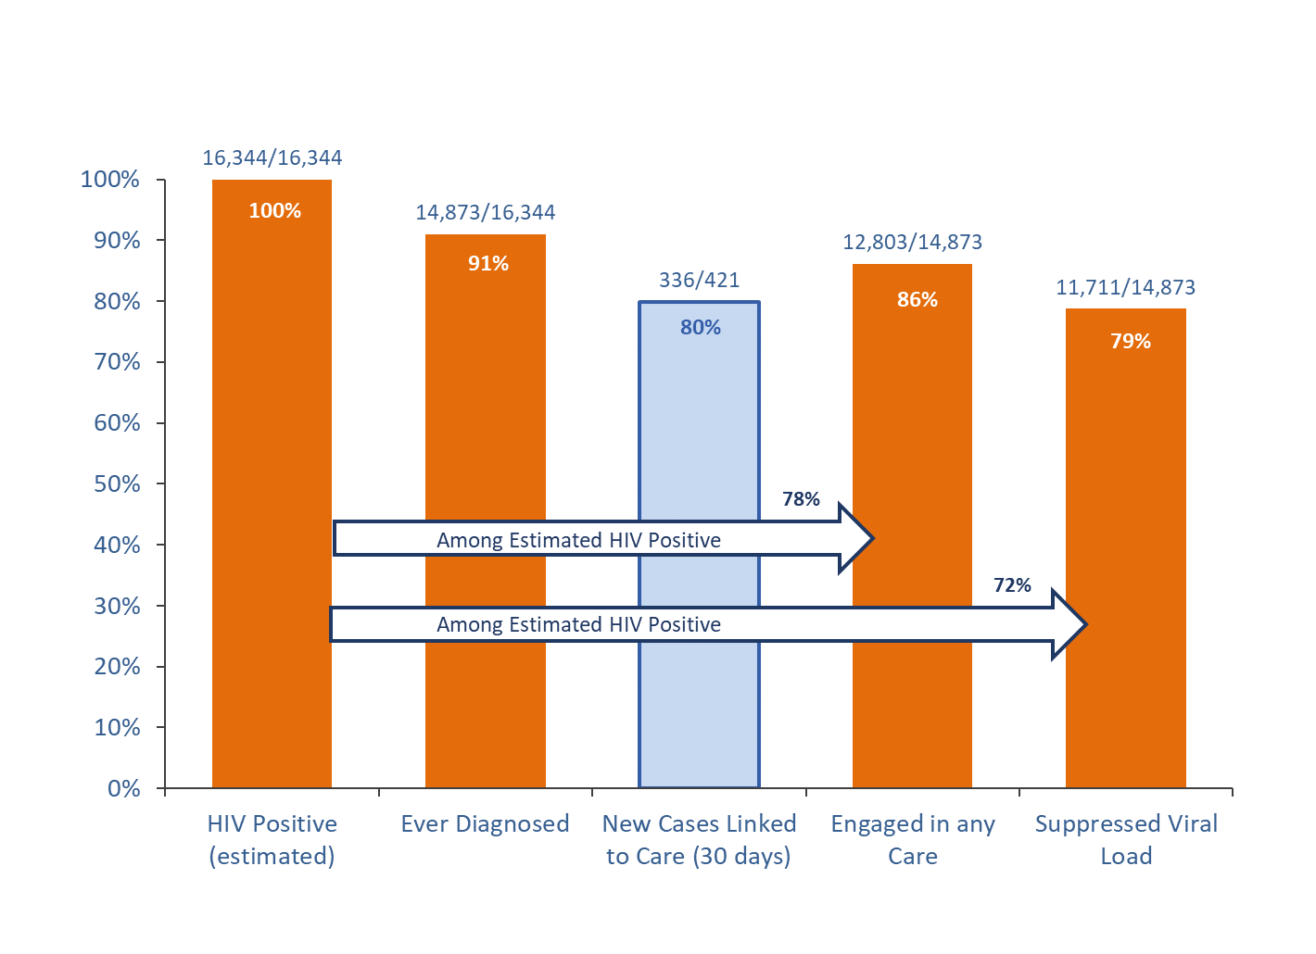
Background
The number of people who are not virally suppressed is a core metric for understanding the HIV epidemic in a jurisdiction
However, the standard surveillance definition makes strong assumptions that likely overestimate the number of people who are out of care
The purpose of this project was to use historical data to model how many people classified as OOC are
Still in a jurisdiction
Truly viremic

Slide 3
Proposal
We propose to refine this assumption by historical data to see what happened when people went out of care
Usually we find out what happened, it just takes a while:
1.) A person returns to care and is viremic
2.) A person is reported in another state
3.) A person is reported as having died
4.) A lab is reported indicating the person has been in care the whole time

Slide 4
Methods

Slide 5
Methods
Identify all people who had a gap between labs of 365 days or more between 1/1/2014 and 12/31/2017
Sample date → Enter Date
As a function of time since a person’s last lab, estimate:
1.) Probability that a person will ultimately be reported in another state or die
2.) Among those who do not leave the state, what is the probability that their next lab will be:
Viremic (Indicating the person was out of care)
Suppressed (Indicating continuous engagement in care)
Stratify by result of last viral load

Slide 6
Application to Present Data
Apply probability weights to current data
For each person who is currently out of care, what is the probability that they are still in WA
If they are here, what is the probability that they are actually OOC?
Create new care continuum adjusted for these estimates
Prevalence: Anyone who has had a lab reported to WA in past 10 years

Slide 7
Results

Slide 8
Outcomes of People With Gaps Between Labs (365+ Days)
Outcome | All | Last Lab Viremic | Last Lab Suppressed
Total | 5581 | 2810 | 3071
Died | 552 (9%) | 262 (9%) | 290 (9%)
Reported Out of State | 971 (17%) | 418 (15) | 553 (18%)
Lab Reported in WA | 1972 (67%) | 1968 (70%) | 1981 (64%)
Never Returned | 409 (7%) | 162 (6%) | 247 (8%)

Slide 9
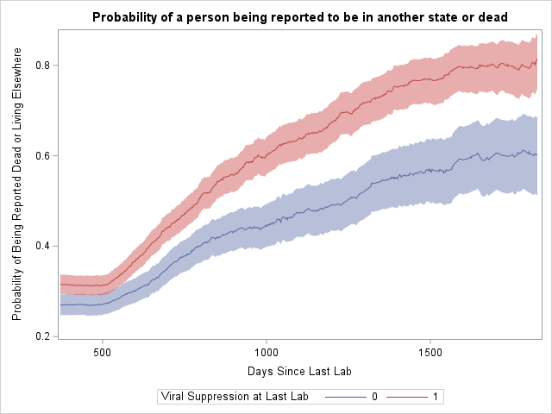

Slide 10
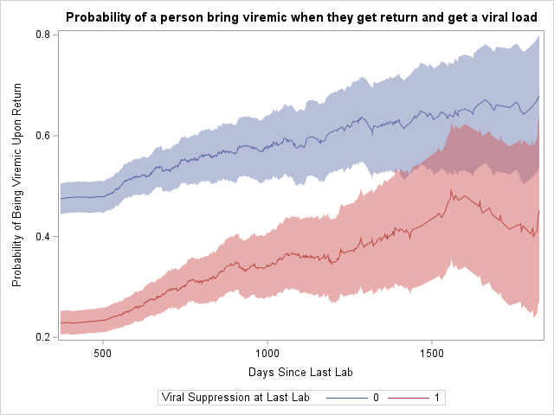

Slide 11
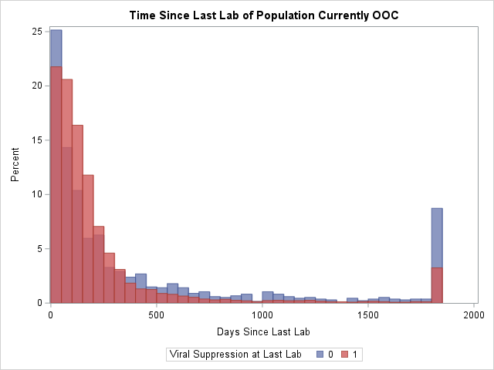

Slide 12
Results
Population | Traditional Methods | Estimated
In Care: Suppressed | 11,927 | 11,927
In Care: Viremic | 925 | 925
Out of Care: Suppressed | 0 | 746 (730-762)
Out of Care: Viremic | 2356 | 387 (379-394))
Total | 15,208 | 13,985
% Suppressed | 78% | 91%

Slide 13
Discussion

Slide 14
Discussion
Our results suggest that only about half of people appear to be are out of care are still in Washington State.
Of these, only about a third are viremic
This has implications for
Program planning
Epidemic modelling
Setting D2C targets

Slide 15
Limitations
We assume that someone’s final state represents what they were doing the whole time we didn’t see them
E.g. it is possible that someone was OOC in Washington and then moved away
Improvements in surveillance practices (RIDR, D2C) could affect the applicability of historical data
If interstate deduplication is improving, the current OOC population may be more likely to represent people who are in WA

Slide 16
Probability Estimates Over Time

Slide 17
What Do You Think About This Approach?
Do the assumptions seem reasonable?
Is it an improvement over the usual method?
What reservations would you have about sharing these estimates publicly?

Slide 18
Try it Yourself!
https://github.com/sjerly/PrevModel
Cross state collaboration?

